Slide 1
If/Else Statements
Notes:
Hi, in this video we’re going to learn how if statements can be expanded to allow Tracy to make decisions between multiple conditions.

Slide 2

What is an If/Else Statement?
An if statement allows Tracy to make decisions.
If it’s a weekday,
Sound alarm at 6am
6:00am
Notes:
In the last lesson, we learned that if statements can be used to have Tracy make decisions. In this scenario, we are checking if it is a weekday. If it is, the alarm will be set for 6am. But what if we wanted to set a different alarm time for weekends?

Slide 3
What is an If/Else Statement?
An if/else statement allows Tracy to make decisions between multiple options.
If it’s a weekday,
Sound alarm at 6am
6:00am
If it’s a weekend,
Sound alarm at 10am
10:00am
Notes:
An if else statement allows Tracy to make decisions between multiple options. In this case, if it is a weekday, the alarm will go off at 6am and if it is a weekend, the alarm will be set for 10am.

Slide 4
What is an If/Else Statement?
If it’s a weekday,
Sound alarm at 6am
6:00am
if weekday:
Alarm at 6am
If it’s a weekend,
Sound alarm at 10am
10:00am
if weekend:
Alarm at 10am
Notes:
In Python syntax, we would write if followed by our condition and then indent the command we want to complete when the condition is met. But if we look closer, we notice there will never be a case where it is not a weekend AND not a weekday. Our choices here are really one or the other, which is where ‘else’ comes in.

Slide 5
What is an If/Else Statement?
If it’s a weekday,
Sound alarm at 6am
6:00am
if weekday:
Alarm at 6am
else
If it’s a weekend,
Sound alarm at 10am
10:00am
if weekend:
Alarm at 10am
Notes:
When we write an if/else statement, we are having Tracy choose between conditions. Unlike if statements, Tracy will be forced to make a choice between the conditions given. To force this, we use else as the final condition in our if else blocks.

Slide 6
Using elif
If it’s a weekday,
Sound alarm at 6am
6:00am
if weekday:
Alarm at 6am
If it’s a Saturday,
Sound alarm at 10am
elif Saturday:
Alarm at 10am
10:00am
If it’s a Sunday,
Sound alarm at 8:30am
else:
Alarm at 8:30am
8:30am
Notes:
We can have as many conditions, or choices, as we want. What if your alarm goes off for school every weekday at 6am, on Saturdays you sleep in so your alarm doesn’t go off until 10am, but on Sundays you have soccer practice, so your alarm goes off at 8:30am? Well, we can write an if else statement with multiple conditions, where we use the structure of if-elif-else. Tracy will have to make a decision between the conditions given to her.

Slide 7
Using elif
6:00am
if Monday:
Alarm at 6am
elif Tuesday:
Alarm at 6:30am
elif Wednesday:
Alarm at 7am
elif Thursday:
Alarm at 8am
elif Friday:
Alarm at 6:15am
elif Saturday:
Alarm at 10am
else:
Alarm at 8:30am
If it’s a Monday, alarm at 6am
If it’s a Tuesday, alarm at 6:30am
6:30am
If it’s a Wednesday, alarm at 7am
7:00am
If it’s a Thursday, alarm at 8am
8:00am
If it’s a Friday, alarm at 6:15am
6:15am
If it’s a Saturday, alarm at 10am
10:00am
If it’s a Sunday, alarm at 8:30am
8:30am
Notes:
We can have as many conditions as we want. If you need a different alarm time every day of the week it’s no problem! Just use if for the first condition, elif for all those in the middle, and else for the final condition.

Slide 8
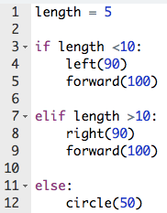
How does Tracy Read If/Else Statements?
True
Complete commands
Skip following conditions and move to code below.
Notes:
Let’s break down the different scenarios in this code.
Our length variable has been set to 5. Tracy checks the first condition, which is length is less than 10, which is true. Tracy completes the commands indented beneath. Once these commands are completed, (Click for arrow and label) Tracy skips the other conditions and completes the code found below the if-else statement.

Slide 9
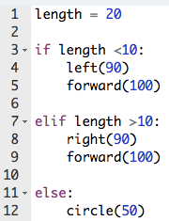
How does Tracy Read If/Else Statements?
False
Check next condition
True
Complete commands
Skip following conditions
Notes:
In this case, our length value is set to 20. Tracy checks the first condition, length is less than 10, and determines that it is false. (Click for label) She then moves to the next condition, length is greater than 10, which is true, so she completes the commands beneath it. (Click for arrow and label) Once these commands are completed, she moves to the code that follows.

Slide 10
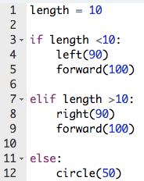
How does Tracy Read If/Else Statements?
False
Check next condition
False
Move to else block
Complete commands
Notes:
When our length value is set to 10, Tracy checks the first condition to see if length is less than 10, and finds it is false, so she moves to check the next condition.
(Click for label) She finds this condition false as well, so she moves to the next condition.
(Click for label) After checking all other conditions and finding them all false, Tracy completes the commands found beneath the else block and draws a circle.

Slide 11
Writing an if/else Statement
if condition:
If true, run the commands here
elif condition:
If first condition false,
if true, run the commands here
else:
If no other conditions are
true, run the commands here
Notes:
The syntax we use for an if statement is simple, but we need to pay close attention to indentation!
We start our if else statement with if and then write the condition followed by a colon. All commands to be performed when this condition is true are indented below.
We write our elif conditions in a similar manner, using the word elif and the condition and then a colon. All commands are indented below.
The statement concludes with the word else followed by a colon. We don’t place a condition next to the word else because this is performed any time the other conditions are false. The commands to be performed are indented below.
Let’s take a look at using if-else statements in some Tracy programs.

Slide 12
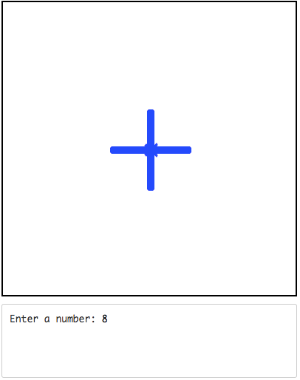
Example #1: Positive, Negative, Zero
Write a program that asks the user for a number and then draws:
Plus sign if positive
Minus sign if negative
Zero if anything else
Notes:
In this program, we are asked to graphically represent if a number entered by a user is positive, negative, or zero by drawing a plus sign, minus sign, or zero.

Slide 13
Commands Learned this Lesson
Command | What does it do?
if condition: Commands elif condition: Commands else: Commands | Declares an if else statement where Tracy will decide between multiple options.
Notes:
In this lesson, we learned how to use if else statements to have Tracy make decisions between multiple conditions. Use if-else statements to write the next set of Tracy programs.

